Slide 1


MIS 665 Final Deliverable
Brady Mathews
Click on me!

Slide 2

Problem Description & Introduction
Sports Marketing Competition
We are analyzing whether or not someone will defect
This will help with marketing efforts

Slide 3
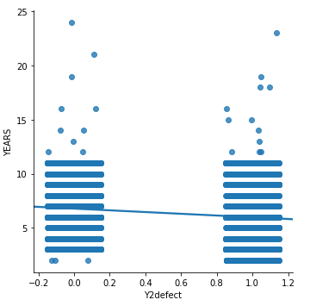
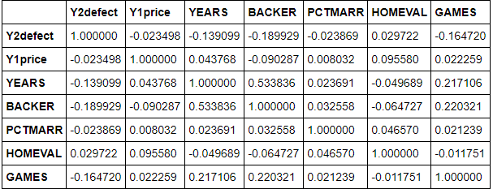
Data Visualization & Analysis
Visualization showed people who defect attended less games
Correlation analysis showed that not many variables were significant
Many columns had little to no impact

Slide 4
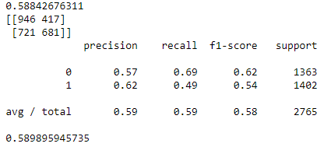
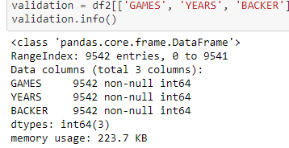
Model Selection
Tried Decision Tree, KNN, and Logistic Regression
Went with Decision Tree at about 59% accuracy
Used GAMES, YEARS, & BACKER as predictive variables

Slide 5

Storytelling
Backer, Games, and Years most significant variables
Try to increase backer club numbers
Try to increase individual game attendance
Last one!

